Slide 1
QUANTEC and MU Quiz
Session 8

Slide 2
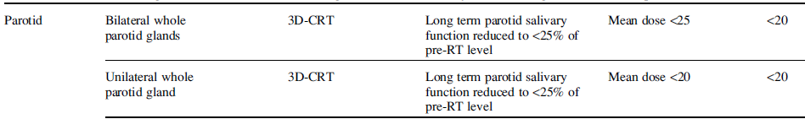
Q1. QUANTEC
Fill in the blanks.
How do they compare to your institutions constraints?
Explain the difference between a parallel and a serial organ. Give examples.

Slide 3
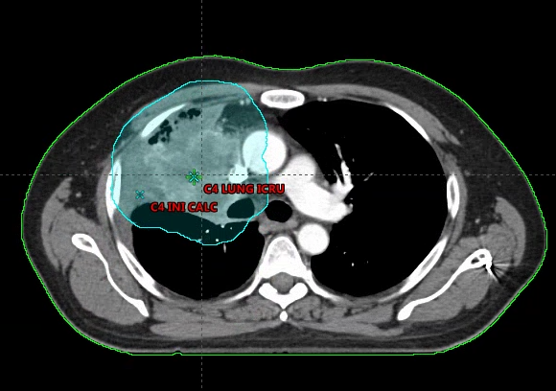
Q2. Lung
Please describe what beam arrangement you would use?
Typical OAR constraints?
Heart: Mean < 26Gy, Lung-GTV: V20<30%, Spinal Cord <45 Gy

Slide 4
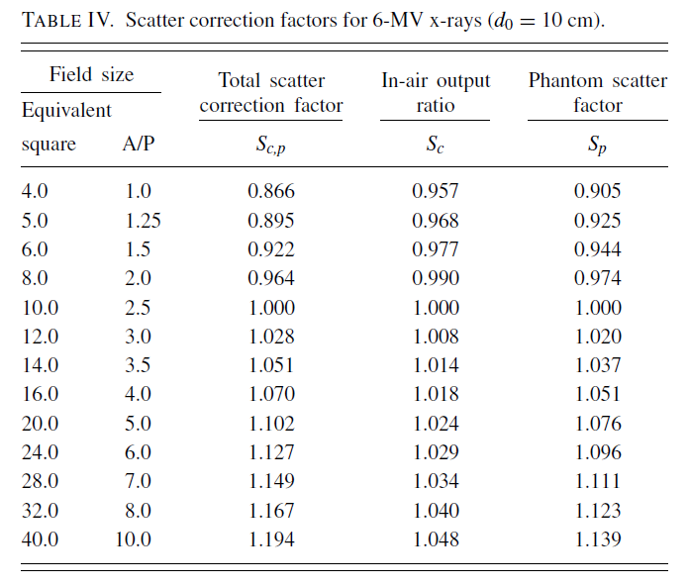
Q3. MU calc - Photon
What monitor-unit setting is necessary to deliver 200 cGy to a point at mid-separation in a phantom 20 cm thick. The phantom is irradiated with parallel opposed fields with a collimator setting of 12 x 20 cm. Fields are blocked to a 10 x 16 cm field using MLC at patient surface. A 6 MV beam is used. Fields are weighted 3 to 1 and the dose is prescribed to the 98% IDL. At 100 SAD.
First calculate the equivalent squares:
12 x 20 = 15 ; 10 x 16 = 12.3 at surface, 13.7 at depth

Slide 5
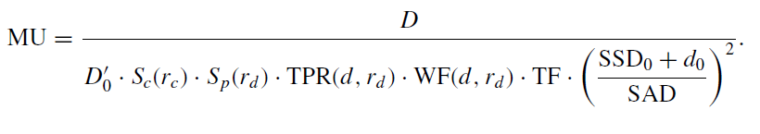
Q3 cont. MU calc - Photon
First Field: Dose = ((200 x ¾)/(0.98) = 153.1
Second Field : Dose = ((200 x ¼)/(0.98) = 51.0

Slide 6
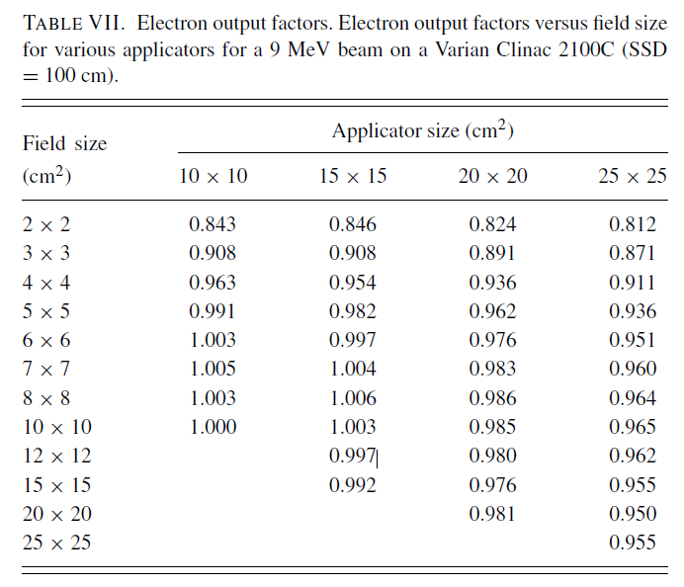

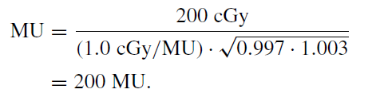
Q4. MU calc - Electron
Calculate the MUs required to deliver 200 cGy to a depth of dm at 100-cm SSD for a 6 × 10-cm² insert in a 15 × 15-cm² applicator.
Note: calibration at 100 SSD, rc= 10x10cm, dmax = 2.1 cm

Slide 7
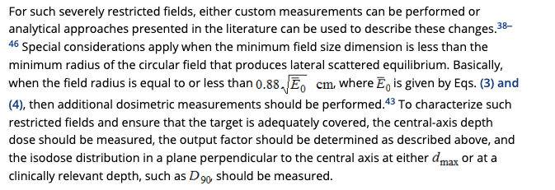
TG-70 Ref

